Slide 1
Situational Awareness: Construction Site Safety “Increased security = increased inconvenience”
If you see something, say something.
Assess surroundings for threats.
What should be normal in your area/situation?
Identify and gauge the danger of elements around you.
All contractors should diligently adhere to all safety protocols.
Use your imagination to plan for different situations.
Address those who aren’t following protocols.
Try to identify threats.
Fight against complacency.
Notes:
Each student and staff member’s security depends on you. Security comes at a cost; usually the cost of convenience. The foundation of security rests upon information gathering. Authorities cannot act if they are unaware of potential incidents. No matter how minor the information may seem, it is imperative that the information be shared with authorities (school administration and law enforcement). Always assess your area for threats and what appears to be out of the ordinary throughout the campus. Avoid distractions. Each person knows and recognizes what is normal in their specific work location. The safety of each person depends on everyone following all safety protocols.
Think through different situations and plan accordingly. This is key to personal preparedness.
Finally, don’t allow complacency to take place. Situations occur when people least expect them. Always be prepared.
Safety and security requires continued vigilance.

Slide 2
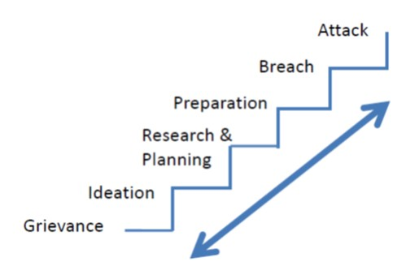
Situational Awareness: Pathway to Violence
Grievance
Ideation
Research / Planning
Preparation
Breach
Attack
Source: U.S. Department of Justice, Federal Bureau of Investigation (2017); Calhoun and Weston (2003)
Notes:
There is no demographic profile of a targeted violence offender. Objective assessment of threat enhancing and mitigating circumstances is the key to evaluating concern for violence. Any individual, no matter what age, sex, race, religion, education or income level, marital status, or occupation, has the potential to engage in targeted violence. The first step in preventing future violence is identifying and evaluating a person’s behaviors. No single behavior is predictive of targeted violence; rather, a “perfect storm” sometimes develops based on a multitude of factors and conditions. When conducting an assessment, the facts and circumstances identified in this chapter must each be examined while focusing on the person of concern, the potential target(s), the situation, and the setting. Threat assessment is a multifaceted process, stemming from a holistic analysis of the pattern of behaviors displayed by a person of concern.
Elementary risk factors differ from middle and high school and are typically external in nature.
Source: Making Prevention a Reality: Identifying, Assessing, and Managing the Threat of Targeted Attacks. U.S. Department of Justice, Federal Bureau of Investigation (2017)

Slide 3
Pathway to Violence: Grievance
Significant personal loss, humiliation or setback; whether perceived or real.
Could be against person, institution or other entity.
Lack of interest to non-violent resolutions to a grievance.
Deliberate or inadvertent disclosure of violent or future plans.
Source: U.S. Department of Justice, Federal Bureau of Investigation (2017)
Notes:
The traditionally known pathway to violence model is an excellent place to begin the discussion because it addresses the question of “why?” It describes a first step on the journey toward intended violence as the formation of a deeply held personal grievance or humiliation based upon real or imagined injustices inflicted upon the grievant. This grievance could be against an individual, an institution, or other entity the person of concern feels slighted or wronged him. It may be nurtured and cultivated over time, even years. Depending upon the particular individual, it may be plainly evident to all around him or kept hidden and private. Although there are cases of targeted violence in which a grievance or motivation was never identified, this appears to be rare with regard to the kind of mass targeted violence attacks this guide addresses. Regardless of whether a specific grievance exists or can be pinpointed, only a few general motives for mass targeted violence offending appear to be prevalent in the experience of the BAU. They include:
Revenge for a perceived injury or grievance
Quest for justice (as defined by the offender)
Desire for notoriety or recognition
Desire to solve a problem perceived to be unbearable
Desire to kill or be killed
Source: Making Prevention a Reality: Identifying, Assessing, and Managing the Threat of Targeted Attacks. U.S. Department of Justice, Federal Bureau of Investigation (2017)

Slide 4
Pathway to Violence: Ideation
Pervasive, persistent fantasies where offender victimizes others.
Problematic or concerning interpersonal interaction with others (being bullied or bullying).
Compromised ability to cope with stressors or setbacks.
Increased isolation, depression and withdraw.
Preoccupation with past attacks or attackers.
Escalated interest in obtaining firearms and/or explosives.
Escalated interest in tactical gear, clothing or paraphernalia.
Source: U.S. Department of Justice, Federal Bureau of Investigation (2017)
Notes:
When a person of concern for targeted violence is unable to resolve the negative emotional burden of unachieved justice, he could then progress to a violent ideation: the idea that violence is an acceptable, or even the only, means of achieving redress. Unable to shake off a grievance and its accompanying anger, despair, humiliation, or other negative emotional responses, the person of concern may eventually conclude that violence is justified, necessary, and his only choice. The adoption of this idea can be profoundly relieving, almost like a salve on a wound. It is for this reason that a sudden turnaround by a formerly angry, depressed, or menacing person of concern should not be presumed as good news. More assessment is often prudent.
Expressed violent ideations can also offer hints about targeting, means of potential attack, or other vital clues to the thoughts and plans of a person of concern.
Source: Making Prevention a Reality: Identifying, Assessing, and Managing the Threat of Targeted Attacks. U.S. Department of Justice, Federal Bureau of Investigation (2017)

Slide 5
Pathway to Violence: Research and Planning
Consideration of when, how and where to attack.
Researching methods, the target, past incidents and/or past offenders.
May consider both practical and symbolic reasons when selecting a target.
Source: U.S. Department of Justice, Federal Bureau of Investigation (2017)
Notes:
Once a person of concern decides that violence should or must be used to seek justice for real or perceived wrongs, under most circumstances he must then begin to think and plan. The person of concern then considers when, how, and where to offend. He can craft and refine his plan by researching methods, the planned target, past offenders, and previous targeted violence incidents. The person of concern may consider both practical and symbolic reasons when selecting potential targets. As with other steps along the pathway, research and planning need not cease when the next step begins; it can and may comingle with other steps.
Source: Making Prevention a Reality: Identifying, Assessing, and Managing the Threat of Targeted Attacks. U.S. Department of Justice, Federal Bureau of Investigation (2017)

Slide 6
Pathway to Violence: Preparation
Procuring means for the attack.
Obtaining skills for the attack.
Pre-attack staging or cocooning (seeking isolation).
Red-Zone Indicators (Imminence).
Dramatic change in appearance or hygiene
Cleansing/purifying: abrupt or inexplicable cessation of drugs, alcohol or medication
Legacy tokens: letters, videos, blogs, communications to claim responsibility and indicate motivation. Live streaming is a new trend.
Source: U.S. Department of Justice, Federal Bureau of Investigation (2017)
Notes:
The person of concern may acquire the equipment, skills, and/or any other resources necessary to conduct the attack. This can include obtaining weapons and gear as well as familiarization of and practice with the weapons. The person may conduct an actual or virtual rehearsal of any aspect of the attack (e.g., driving the intended route to the site). It can also include farewell writings or other end of life planning, or creation of artifacts meant to be left behind to claim credit and explain motive.
Source: Making Prevention a Reality: Identifying, Assessing, and Managing the Threat of Targeted Attacks. U.S. Department of Justice, Federal Bureau of Investigation (2017)

Slide 7
Pathway to Violence: Breach
Circumvention or testing of security measures.
Conducting dry runs.
Cyber intrusion.
May occur immediately prior to attack or earlier.
Source: U.S. Department of Justice, Federal Bureau of Investigation (2017)
Notes:
This step involves circumvention of security measures or boundaries at the target location. Breach activities can include conducting dry runs, engaging in approach behaviors to include stalking, and testing security at the target location. In practice, the BAU has expanded this definition to include cyber intrusion behaviors where these breaches may be intended to identify security plans and weaknesses, gain protected information about a target, or otherwise further an attack plan via unauthorized access to systems. Breach behavior may occur immediately prior to an attack, or earlier.
Source: Making Prevention a Reality: Identifying, Assessing, and Managing the Threat of Targeted Attacks. U.S. Department of Justice, Federal Bureau of Investigation (2017)

Slide 8
Pathway to Violence: Attack
Violence against preplanned and/or opportunistically chosen targets.
Culmination of highly personalized quest for justice which, ultimately, may only be known to the offender.
Source: U.S. Department of Justice, Federal Bureau of Investigation (2017)
Notes:
An offense may involve violence against both preplanned and opportunistically chosen targets. Both practical and symbolic acts may occur. The violent offense is the culmination of a highly personalized quest for justice which may, ultimately, only be fully understandable to the offender.
Source: Making Prevention a Reality: Identifying, Assessing, and Managing the Threat of Targeted Attacks. U.S. Department of Justice, Federal Bureau of Investigation (2017)

Slide 9
Pathway to Violence: Opportunities for Identification
Leakage (disclosure).
Social media.
Not letting go of an issue.
Expressing violent solutions to problems.
Direct or indirect threats of violence.
Physical violence towards persons or property.
Fixations on mass targeted violence.
Suicidal behaviors or statements.
Source: U.S. Department of Justice, Federal Bureau of Investigation (2017)
Notes:
Leakage has been defined as a communication to a third party of intent to do harm to a target through an attack.
Homicide and suicide are more closely linked than many think. In many cases multiple homicides are linked with prior suicide attempts, gestures, or suicidal ideation on the part of the perpetrator. This is especially true with targeted violence. A “Safe Schools Initiative” research project revealed that 78% (32 of 41 studied) of targeted mass attackers exhibited a history of suicide attempts or suicidal thoughts at some point prior to their attack. Moreover, many offenders attempt or succeed at suicide or “suicide by cop” at the conclusion of a targeted violence event.
If you become aware of these indicators, notify your administration. Most of these factors will not violate the law or justify a Baker Act. The focus is to get help where help is needed.
Source: Making Prevention a Reality: Identifying, Assessing, and Managing the Threat of Targeted Attacks. U.S. Department of Justice, Federal Bureau of Investigation (2017)

Slide 10
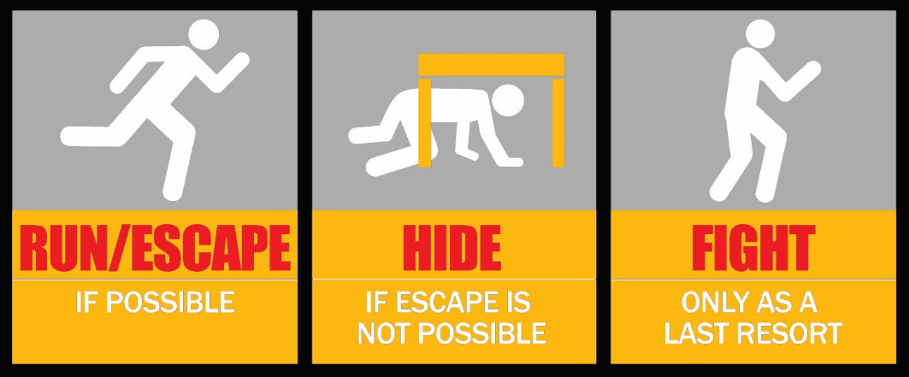
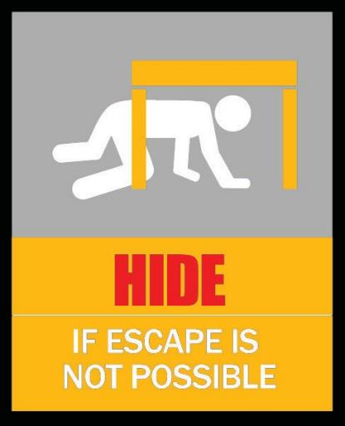
RUN!
IF POSSIBLE AND SAFE TO DO SO, FLEE THE AREA TO SAFETY.
Notes:
Fleeing danger is the best option if it is safe to do so. If the environment outside your location is more dangerous than your location, then locking down may be your best option. This is a judgment call on each faculty/staff member’s part.
Decisions will always be questioned. With this in mind, be decisive.

Slide 11
RUN: If possible & safe, Flee!
What is a safe location?
Meet location; reunification.
Have multiple escape routes and plans in mind
Evacuate regardless of whether others agree to follow.
Leave your belongings behind.
Help others escape, if possible.
Auditory distortion – identifying location of the threat?
Prevent individuals from entering the area of the active shooter.
Keep your hands visible.
Follow the instructions of law enforcement.
Do not attempt to move wounded people.
Call 911 when you are safe.
Notes:
A safe location could be a ‘safer’ location than your present location, or it could be away from your location altogether. Again, one must determine if safety is enhanced or compromised by fleeing. If you are in doubt, remain in your safe location until you determine it is safer to flee. During transition times, assemblies, arrival and/or dismissal, fleeing may be the only option.
Having multiple escape routes and escape plans in mind will assist you in determining what is best in your current situation. Active shooters have chained exterior doors shut to trap victims.
Under stress and due to the environment, it is difficult to determine where the danger is. Gunshots inside a school campus will sound very different than gunshots in an open environment. Consider a car back-firing in a parking lot.
When fleeing, keep your hands visible as that is what law enforcement is trained to look at. Strictly follow their instructions and allow then to do their job.
You cannot safely move wounded people when there is an armed individual moving around the facility.
Call 9-1-1 when you and your group are in a safe location.

Slide 12
HIDE!
IF FLEEING IS NOT POSSIBLE, QUICKLY MOVE (USHER OTHERS FROM IMMEDIATE AREA) TO NEAREST LOCKABLE ROOM, LOCK DOORS, BARRICADE (IF POSSIBLE), AND COMPARTMENTALIZE.
Notes:
If safe to do so, usher people into your safe location.
Armed aggressors, like water, follow the path of least resistance. Remove their opportunity to hurt you/others.

Slide 13
HIDE: Move to lockable room, barricade & compartmentalize.
Everything is in play / an option.
Explore technology / tools to barricade.
Usher others to safety as long as it’s safe to do so.
Your hiding place should:
Be out of the aggressor’s view
Provide protection if shots are fired in your direction (i.e., an area with a closed and locked door)
Not trap you or restrict your options for movement
Notes:
Staff members should develop plans of action for their specific locations. Each location is unique and requires thought to use your environment to your advantage.
All desks, chairs, tables, computers, ANYTHING can be used to protect yourself. Identify items to be used to barricade and items that could be used as a weapon. Give yourself permission to use anything to protect yourself and others when life is in danger.

Slide 14
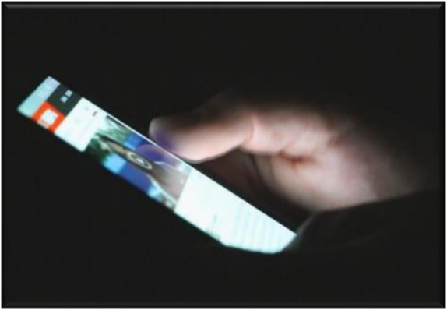
Turn off lights and stay quiet.
Cell phones need to be off or silent; remember cell phone backlight.
Cover windows, including door window.
DON’T DRAW ATTENTION!
Notes:
One potential problem with active shooter incidents is that students use their phones to notify parents and social media. We will not be able to effectively control this; however, we should discourage it to the extent that using phones draws the attention of the aggressor(s). The goal of being locked down is to not be seen, heard or draw attention.

Slide 15
Once locked down, no one else will be allowed in.
You do not know who the aggressor is.
You do not know where the aggressor is.
You MUST provide for the safety of those in your immediate care.
Pre-plan: those locked out must RUN!
Notes:
Why? The question is one of reasonableness: would a reasonable person lock out students/persons when there is no immediate threat present or would a reasonable person allow proximal students/people into their location before locking down?
Once you lock the door and barricade, do not allow anyone else to come in. This prioritizes the need to train students who are locked out to flee to safety. Once locked down, barricade yourself if possible and compartmentalize (lock down in other rooms) if possible.

Slide 16
Stay away from doors and windows.
Stay out of sight.
In the event the aggressor(s) attempt to gain access into your locked and/or barricaded area:
Prepare to fight!
Arm yourself
Stack for door breach
Notes:
Do not draw attention. If all of your efforts to hide are being circumvented by the aggressor, prepare to fight. Defending yourself and identifying improvised weapons will be covered later in the presentation.

Slide 17
Remain calm, think clearly, identify improvised weapons and arm yourself.
Defend yourself if confronted.
Be the leader.
Start planning.
Ask yourself, “Can I escape?”
Notes:
If you are confronted by the aggressor(s), FIGHT! As faculty/staff members, take control of your specific situation. Organize those in your immediate area and plan. What if the aggressor comes here? Always be mindful of escape routes and opportunities. Pay close attention to your surroundings.
Defending yourself and identifying improvised weapons will be covered later in the presentation.

Slide 18
Can I flee to a safer location?
Be mindful of all possible escape routes.
Would it be safer to move or remain in current location?
Notes:
Always be mindful of primary and alternate escape routes. If it becomes safer to flee than remain in your current location, flee!
As part of training, identify escape routes in training location.

Slide 19
FIGHT!
IF ABOVE ACTIONS ARE NOT POSSIBLE, AND YOU ARE CONFRONTED, DEFEND YOURSELF.

Slide 20
FIGHT: IF ABOVE ACTIONS ARE NOT POSSIBLE, AND YOU ARE CONFRONTED, DEFEND YOURSELF.
Legal justification for self-defense.
Legal justification in defending others.
Improvised weapons:
What are they
Locate and identify
Notes:
Be prepared for lots of questions.
776.012 Use or threatened use of force in defense of person.—(1) A person is justified in using or threatening to use force, except deadly force, against another when and to the extent that the person reasonably believes that such conduct is necessary to defend himself or herself or another against the other’s imminent use of unlawful force. A person who uses or threatens to use force in accordance with this subsection does not have a duty to retreat before using or threatening to use such force.
(2) A person is justified in using or threatening to use deadly force if he or she reasonably believes that using or threatening to use such force is necessary to prevent imminent death or great bodily harm to himself or herself or another or to prevent the imminent commission of a forcible felony. A person who uses or threatens to use deadly force in accordance with this subsection does not have a duty to retreat and has the right to stand his or her ground if the person using or threatening to use the deadly force is not engaged in a criminal activity and is in a place where he or she has a right to be.
Locate and identify improvised weapons that would be present in a classroom, work area or in the actual training location.

Slide 21
Follow instructions from administrators and/or law enforcement
Real incidents are dynamic and plans have to be modified according to the incident.
Don’t argue with Law Enforcement or Administration.
There is a good reason behind the decisions made and the directions given.
Notes:
Emergency management plans are developed on paper with significant thought; however, real incidents unfold in ways we cannot expect. Due to the dynamics of each incident, decisions are made on evacuation locations, routes, safety zones, etc. to protect the citizenry as well as preserve the crime scene. When advised by law enforcement or administrators, do what they tell you. There are reasons behind the decisions; the most important being safety.

Slide 22
Fire Alarm
If you hear a fire alarm during an active shooter crisis:
Remain in your location.
Use your senses to determine if there is a fire.
If there is a fire at or near your location, run to another safe location.
Notes:
Active shooters have utilized fire alarms to draw innocent people out to them. Under these circumstances, faculty/staff should use their senses to determine if the fire alarm represents a fire threat or is being used to draw people out.

Slide 23
Lockdown / Hide / Barricade
Barricading:
Lockable / not lockable
Improvised tools – cords, belts, etc.
Compartmentalize:
Multiple barriers
Door between aggressor(s) and public
Don’t draw attention:
Stay out of sight
Be quiet
Prepare to fight!
Notes:
Demonstrate and explain these elements
Securing in-swing vs out-swing doors
Tie-downs
Do this only when safe to do so

Slide 24
Fight
Identify improvised weapons.
Formulate strategy:
Who has what?
Stack at door
Stack below muzzle of weapon
First person grabs weapon
Everyone else fights aggressor
Use improvised weapons
Secure weapon.
Interacting with Law Enforcement.

Slide 25
Other Considerations
CPR Training
First Aid Kit and Training
Tourniquet and Training

Slide 26
Questions

