Slide 1
DISCLAIMER
This information has been developed by an OSHA Compliance Assistance Specialist and is intended to assist employers, workers, and others as they strive to improve workplace health and safety. While we attempt to thoroughly address specific topics, it is not possible to include discussion of everything necessary to ensure a healthy and safe working environment in a presentation of this nature. Thus, this information must be understood as a tool for addressing workplace hazards, rather than an exhaustive statement of an employer’s legal obligations, which are defined by statute, regulations, and standards. Likewise, to the extent that this information references practices or procedures that may enhance health or safety, but which are not required by a statute, regulation, or standard, it cannot, and does not, create additional legal obligations. Finally, over time, OSHA may modify rules and interpretations in light of new technology, information, or circumstances; to keep apprised of such developments, or to review information on a wide range of occupational safety and health topics, you can visit OSHA’s website at www.osha.gov.
Notes:
1
1
Brief over disclaimer.

Slide 2
OSHA Injury and Illnesses Recordkeeping and Reporting
Safety Alliance for Excellence
Miami Chapter
Miami, FL
2/6/2019
Vergie Bain
Compliance Assistance Specialist
OSHA Ft. Lauderdale Area Office
954-424-0242

Slide 3
Who is Covered?
All employers covered by the occupational safety and health act (OSH act) are covered
However, most employers, due to partial exemptions, do not have to keep OSHA injury and illness records unless OSHA or the bureau of labor statistics (BLS) informs them in writing

Slide 4
Exceptions
Ten (10) or fewer employees at all times during the last calendar year
BLS or OSHA request
Business establishment is classified in a specific low hazard retail, service, finance, insurance or real estate industry listed in Appendix A

Slide 5
What is Recordable?
New work-related injuries and illnesses:
  Death
  Days away from work
  Restricted work or transfer to another job
  Medical treatment beyond first aid
  Loss of consciousness
  Diagnosis of a significant injury/illness by a physician or other licensed health care professional

Slide 6
What is Recordable?
Needlestick and sharps injuries
Medical removal under OSHA standards
Work-related tuberculosis cases
STS of 10 db with 25 db hearing loss

Slide 7
Medical Treatment
The management and care of a patient to combat disease or disorder
Does not include:
  Visits to a physician or other licensed health care professional solely for observation or counseling
  Diagnostic procedures, such as x-rays and blood tests, including the administration of prescription medications used solely for diagnostic purposes
  “First aid" as defined

Slide 8
First Aid
Using a nonprescription medication at nonprescription strength
Administering tetanus immunizations
Cleaning, flushing or soaking wounds on the surface of the skin;
Using wound coverings such as bandages, Band-Aids™, gauze pads, etc.; or using butterfly bandages or Steri-Strips™
Using hot or cold therapy
Using any non-rigid means of support, such as elastic bandages, wraps, non-rigid back belts, etc.
Using temporary immobilization devices while transporting an accident victim
Drilling of a fingernail or toenail to relieve pressure, or draining fluid from a blister
Using eye patches
Removing foreign bodies from the eye using only irrigation or a cotton swab
Removing splinters or foreign material from areas other than the eye by irrigation, tweezers, cotton swabs or other simple means
Using finger guards
Using massages
Drinking fluids for relief of heat stress

Slide 9
Work-related
Must consider an injury or illness to be work-related if:
  An event or exposure in the work environment either caused or contributed to the resulting condition or significantly aggravated a pre-existing injury or illness
Notes:
How do I handle a case if it is not obvious whether the precipitating event or exposure occurred in the work environment or occurred away from work?
In these situations, you must evaluate the employee's work duties and environment to decide whether or not one or more events or exposures in the work environment either caused or contributed to the resulting condition or significantly a aggravated a pre-existing condition.
How do I know if an event or exposure in the work environment "significantly aggravated" a preexisting injury or illness?
A preexisting injury or illness has been significantly aggravated, for purposes of OSHA injury and illness recordkeeping, when an event or exposure in the work environment results in any of the following:
Death, Loss of consciousness, One or more days away from work, or days of restricted work, or days of job transfer, Medical treatment in a case where no medical treatment was needed for the injury or illness before the workplace event or exposure, or a change in medical treatment was necessitated by the workplace event or exposure.
An injury or illness is a preexisting condition if it resulted solely from a non-work-related event or exposure that occurred outside the work environment.

Slide 10
Expanded Reporting Requirements
The rule expands the list of severe work-related injuries and illnesses that all covered employers must report to OSHA.
All work-related fatalities within 8 hours (same as current requirement)
All work-related in-patient hospitalizations of one or more employees within 24 hours
All work-related amputations within 24 hours
All work-related losses of an eye within 24 hours
Notes:
All covered employers must report
all work related fatalities to OSHA within 8 hours:
All work related in patient hospitalizations to OSHA within 24 hours (previous requirements were to report only 3 inpatient hospitalizations)
All work related amputations to OSHA within 24 hours
All related losses of any eye to OSHA within 24 hours
Please note:
In-patient hospitalization is defined as a formal admission to the in-patient service of a hospital or clinic for care or treatment.
Only fatalities occurring within 30 days of the work-related incident must be reported.
Only in-patient hospitalizations, amputations, or losses of an eye occurring within 24 hours of the work-related incident must be reported.
Employers do not have to report an event if:
It resulted from a motor vehicle accident on a public street or highway, except in a construction work zone (employers must report the event if it happened in a construction work zone).
It occurred on a commercial or public transportation system (e.g. airplane, subway, bus, ferry, street car, light rail, train).
It occurred more than 30 days after the work-related fatality or more than 24 hours after the work-related in-patient hospitalization, amputation, or loss of an eye.
If the in-patient hospitalization was for diagnostic testing or observation only.
We will not respond to every report with an on-site inspection. We expect to address many of the reports through other types of investigations, but we will engage with employers whose workers have been hurt. We are developing the process to determine which incidents to inspect and which to handle using other types of investigations and interventions.

Slide 11
Fatality/Catastrophe Reporting
Do not need to report highway or public street motor vehicle accidents (outside of a construction work zone)
Do not need to report commercial airplane, train, subway or bus accidents
Do not need to report a fatality or hospitalization that occurs outside of thirty (30) days of an incident
Notes:
Employers must report fatality and catastrophe incidents to OSHA within 8 hours, verbally discussing the case with OSHA. The case can be called in to the local area office or phoned in to 1-800-321-OSHA.
Cases may be recordable but not reportable, for example, a fatality due to a motor vehicle accident on a public highway does not have to be reported within 8 hours, but it is a recordable fatality on the 300 Log.

Slide 12
How do I Report an Injury or Illness
Call the nearest OSHA office.
Call the OSHA 24-hour hotline at 1-800-321-6742 (OSHA).
Report online at www.osha.gov
Necessary Information: Business name; names of employees affected; location and time of the incident, brief description of the incident; contact person and phone number.

Slide 13
How does OSHA define "in-patient hospitalization"?
OSHA defines in-patient hospitalization as a formal admission to the in-patient service of a hospital or clinic for care or treatment. Treatment in an Emergency Room only is not reportable.

Slide 14
How does OSHA define "amputation"?
An amputation is the traumatic loss of all or part of a limb or other external body part. This would include fingertip amputations with or without bone loss; medical amputations resulting from irreparable damage; and amputations of body parts that have since been reattached.

Slide 15
Who should report a fatality or in-patient hospitalization of a temporary worker?
The employer that provides the day-to-day supervision of the worker must report to OSHA any work-related incident resulting in a fatality, in-patient hospitalization, amputation or loss of an eye.

Slide 16
May an employer require post-incident drug testing for an employee who reports a workplace injury or illness?
The rule does not prohibit drug testing of employees. It only prohibits employers from using drug testing, or the threat of drug testing, as a form of retaliation against employees who report injuries or illnesses. If an employer conducts drug testing to comply with the requirements of a state or federal law or regulation, the employer's motive would not be retaliatory and this rule would not prohibit such testing.

Slide 17
Electronic Reporting Requirements

Slide 18
Electronic Reporting Requirements
The electronic reporting requirements are based on the size of the establishment, not the firm. The OSHA injury and illness records are maintained at the establishment level. An establishment is defined as a single physical location where business is conducted or where services or industrial operations are performed. A firm may be comprised of one or more establishments.

Slide 19
Injury Tracking Application (ITA)
ITA is a secure website with 3 options for data submission:
  Manually enter data into a webform
  Upload CSV (comma-separated values) file to process single of multiple establishments at the same time
  Users of automated recordkeeping systems can transmit data electronically via an Application Programming Interface (API)

Slide 20
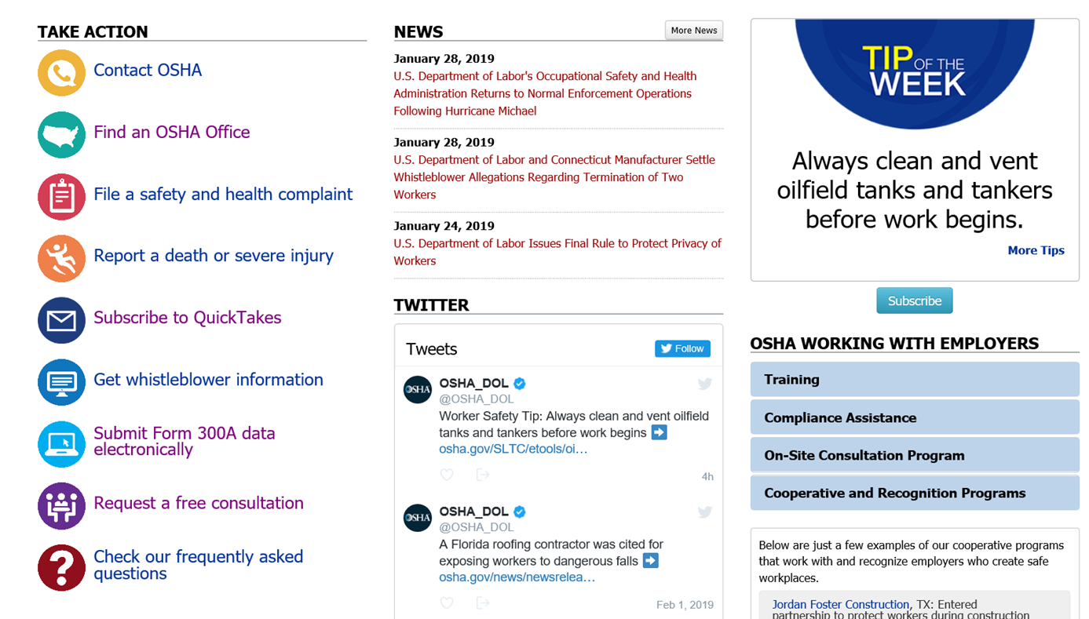
Just Start with OSHA’s Home page

Slide 21
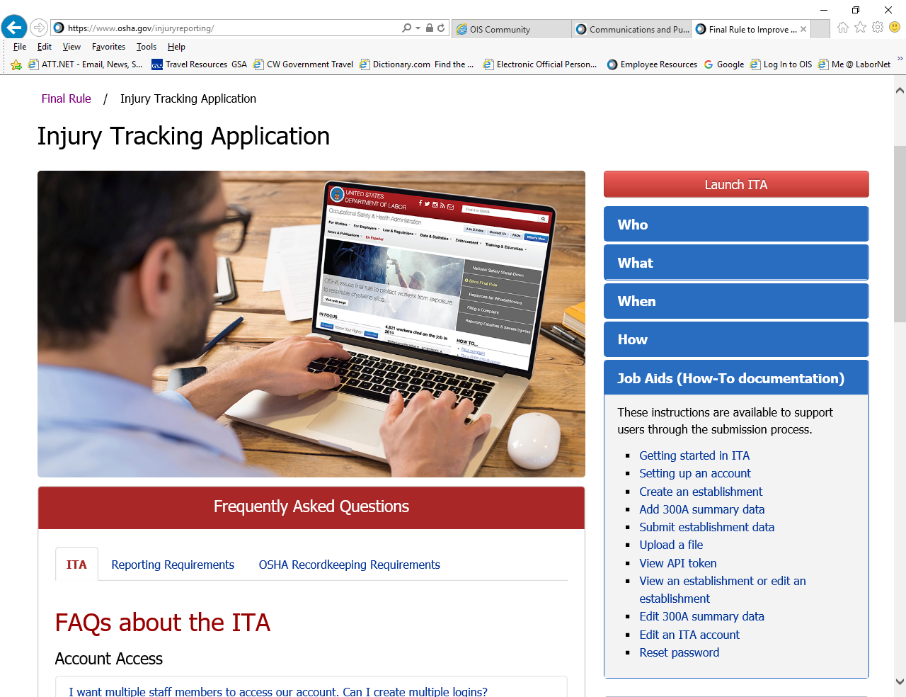

Slide 22
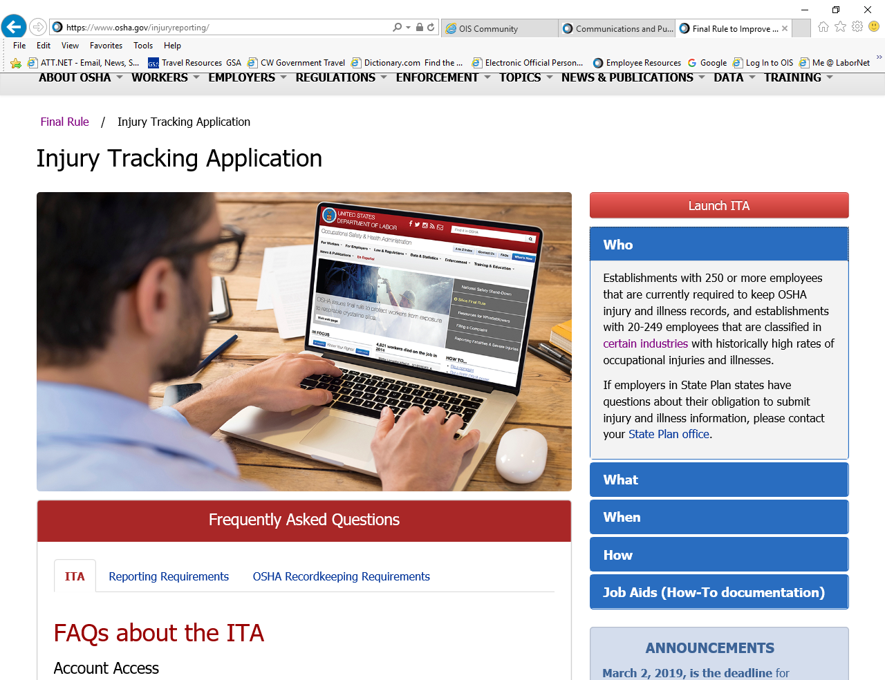

Slide 23
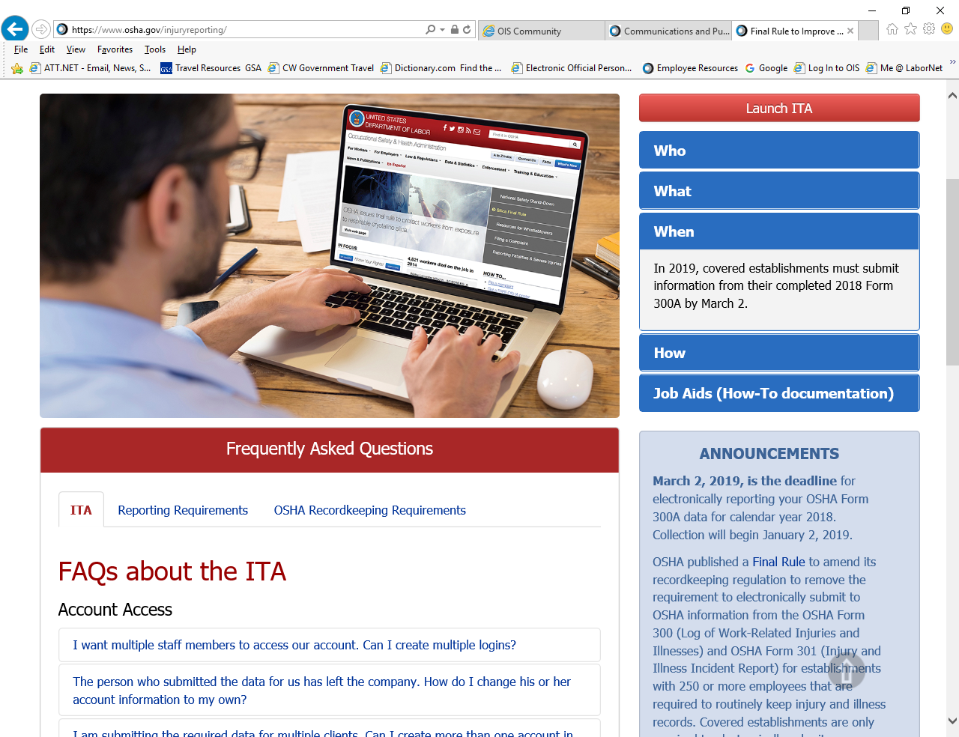

Slide 24
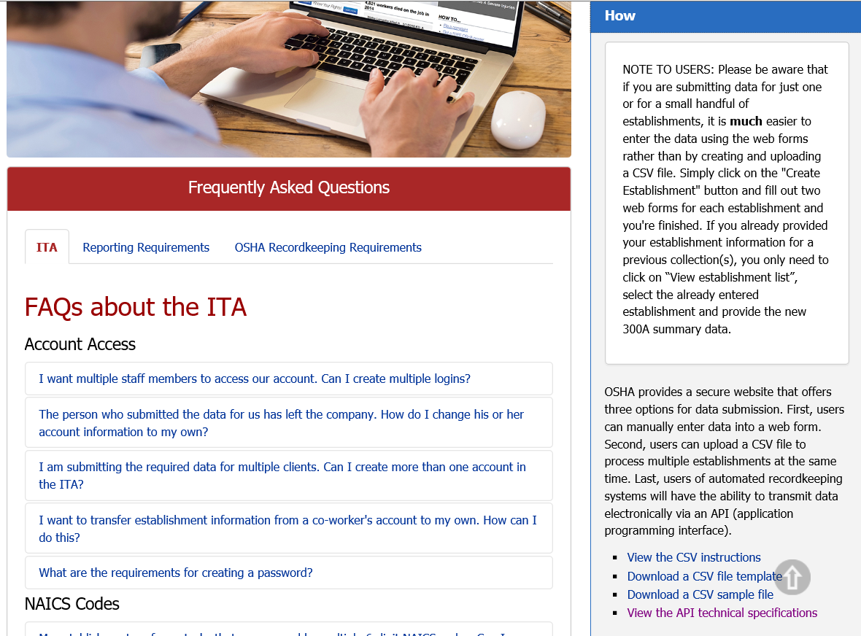

Slide 25
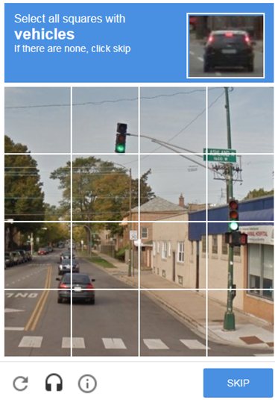

Slide 26
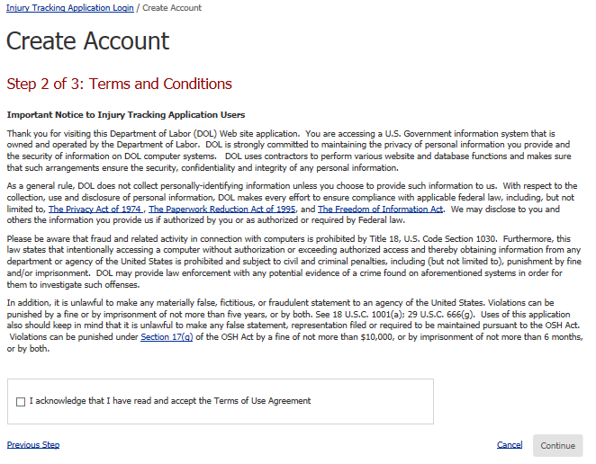

Slide 27
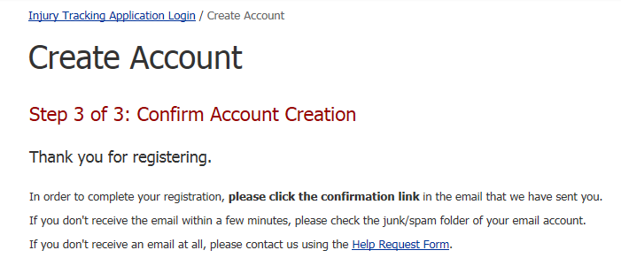

Slide 28
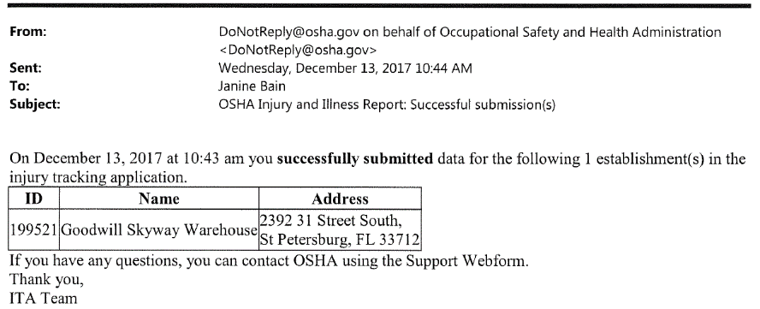
Letter of Submission

Slide 29
Final Rule
March 2, 2019, is the deadline for electronically reporting your OSHA Form 300A data for calendar year 2018.
OSHA published a Final Rule to amend its recordkeeping regulation to remove the requirement to electronically submit to OSHA information from the OSHA Form 300 (Log of Work-Related Injuries and Illnesses) and OSHA Form 301 (Injury and Illness Incident Report) for establishments with 250 or more employees that are required to routinely keep injury and illness records. Covered establishments are only required to electronically submit information from the OSHA Form 300A (Summary of Work-Related Injuries and Illnesses). The requirement to keep and maintain OSHA Forms 300, 300A, and 301 for five years is not changed by this Final Rule.

Slide 30
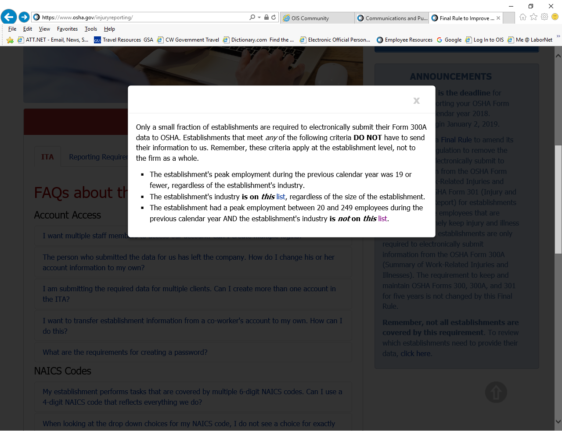

Slide 31
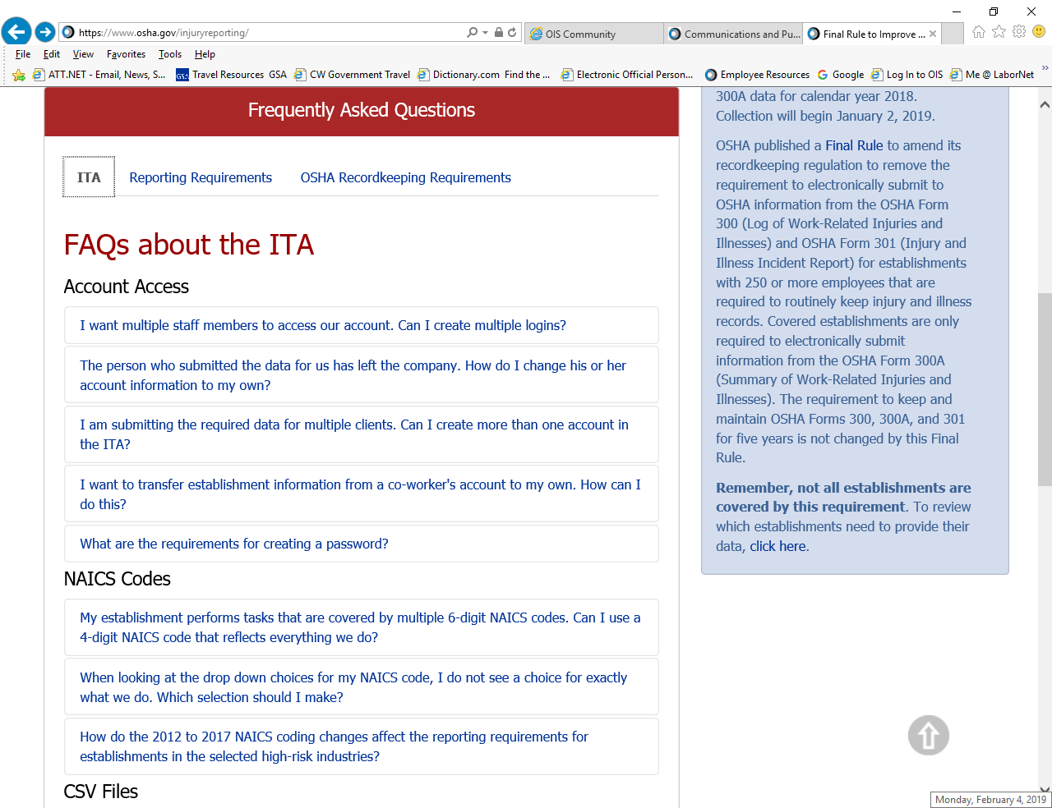
FAQs about the Reporting Requirements

Slide 32
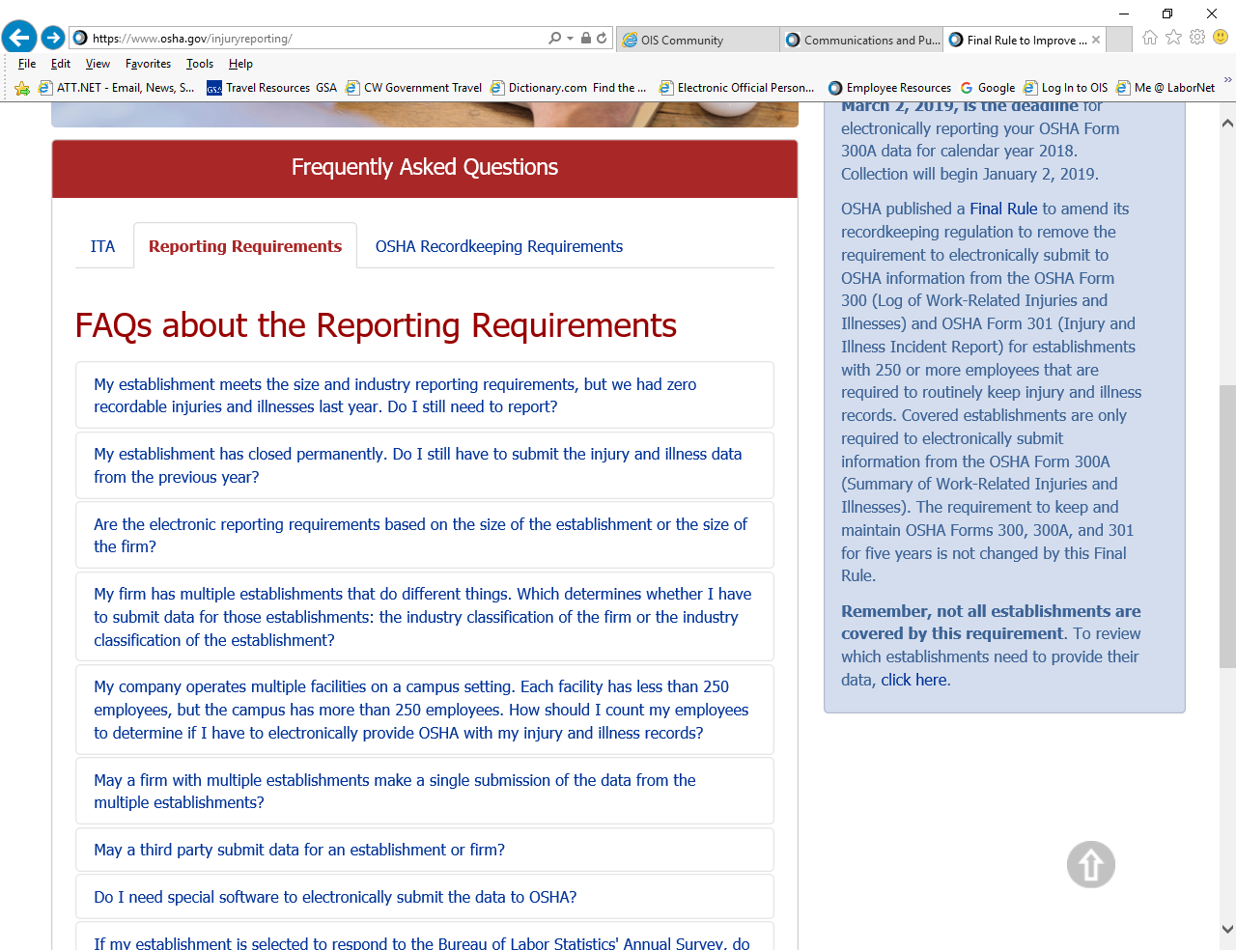
FAQs about the Reporting Requirements

Slide 33
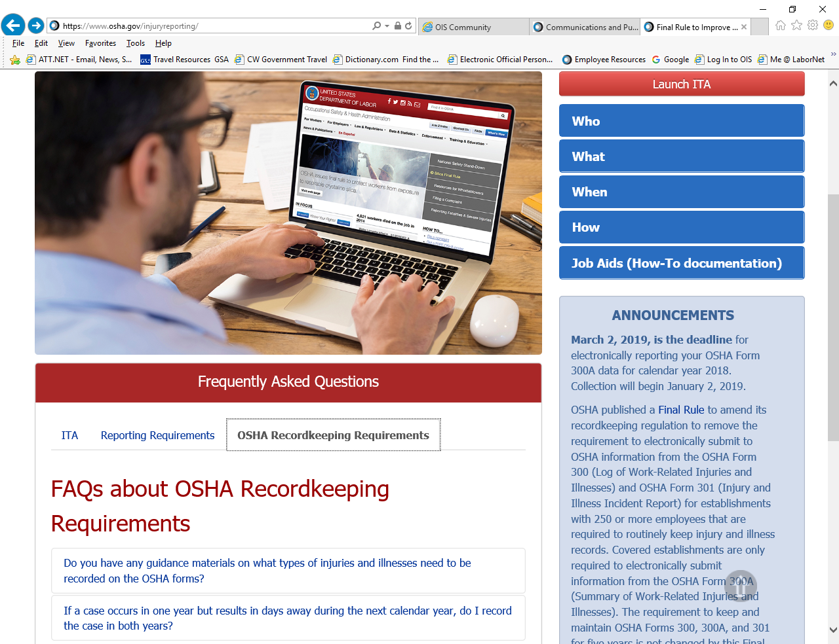
FAQs about the Reporting Requirements

Slide 34
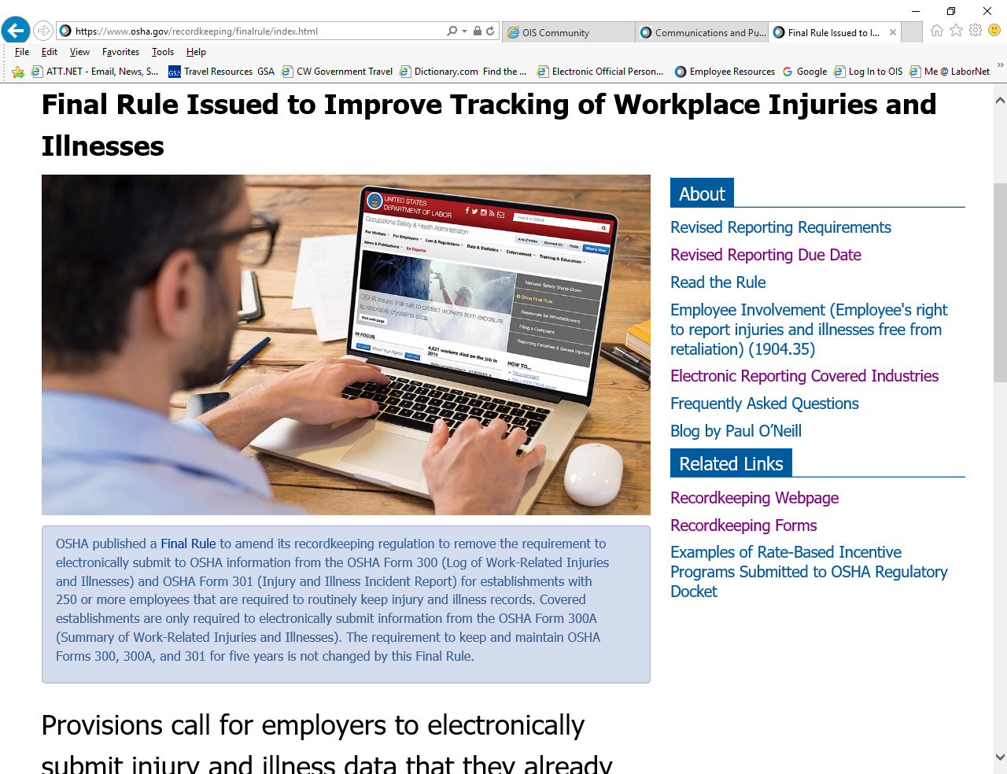
Final Rule

Slide 35
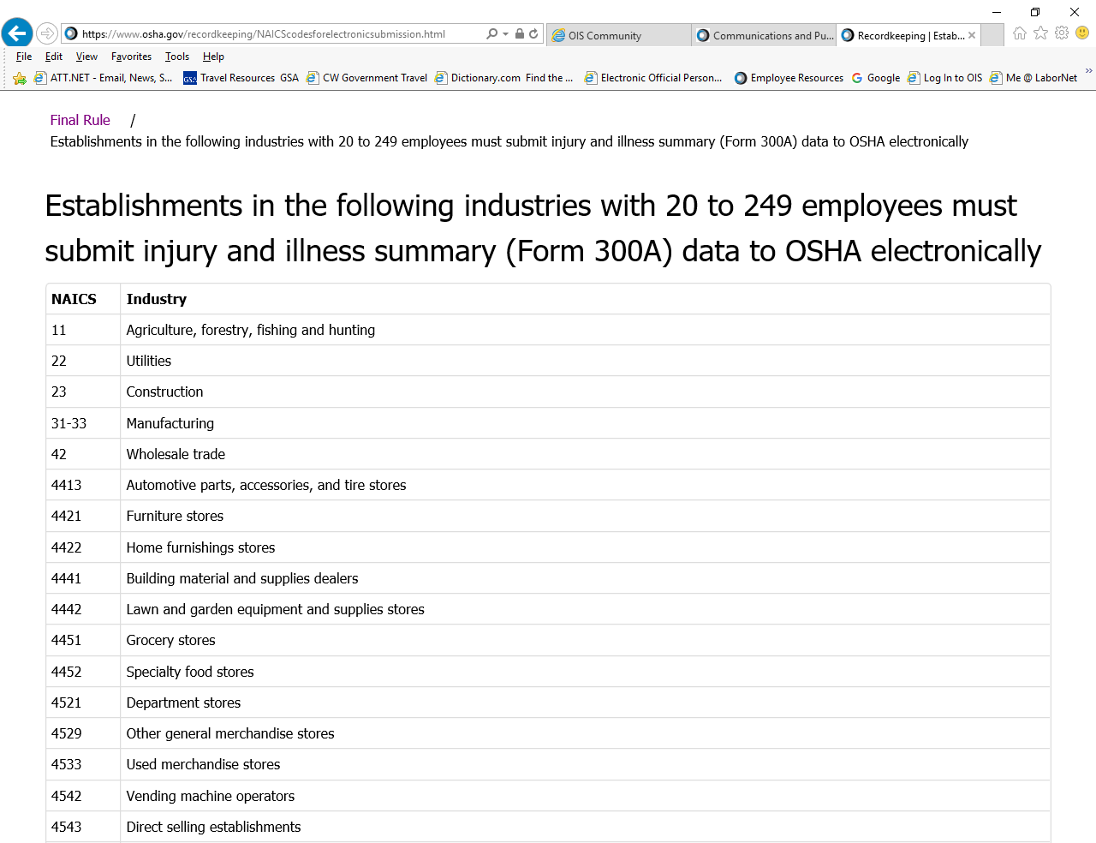
Final Rule

Slide 36
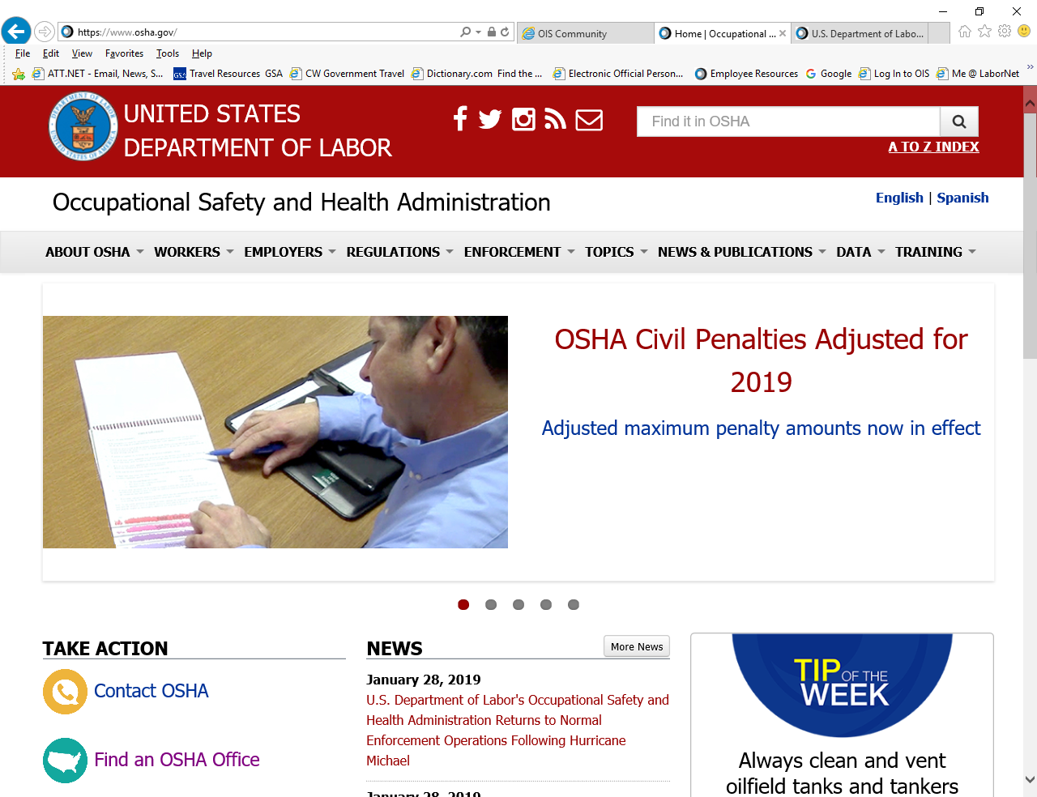

Slide 37
OSHA Penalties
Type of Violation | Penalty
Serious Other-Than-Serious Posting Requirements | $13,260 per violation
Failure to Abate | $13,260 per day beyond the abatement date
Willful or Repeated | $132,598 per violation
As of 1-23-2019

Slide 38
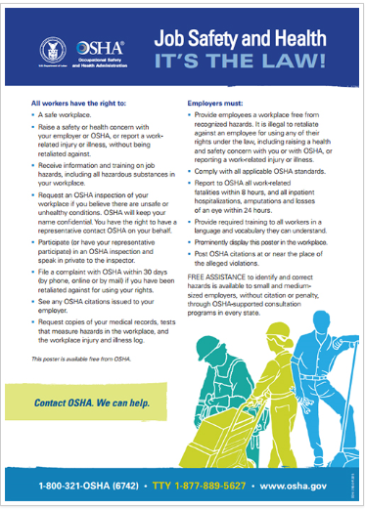
www.osha.gov
1-800-321-OSHA (6742)
Notes:
38

Slide 39

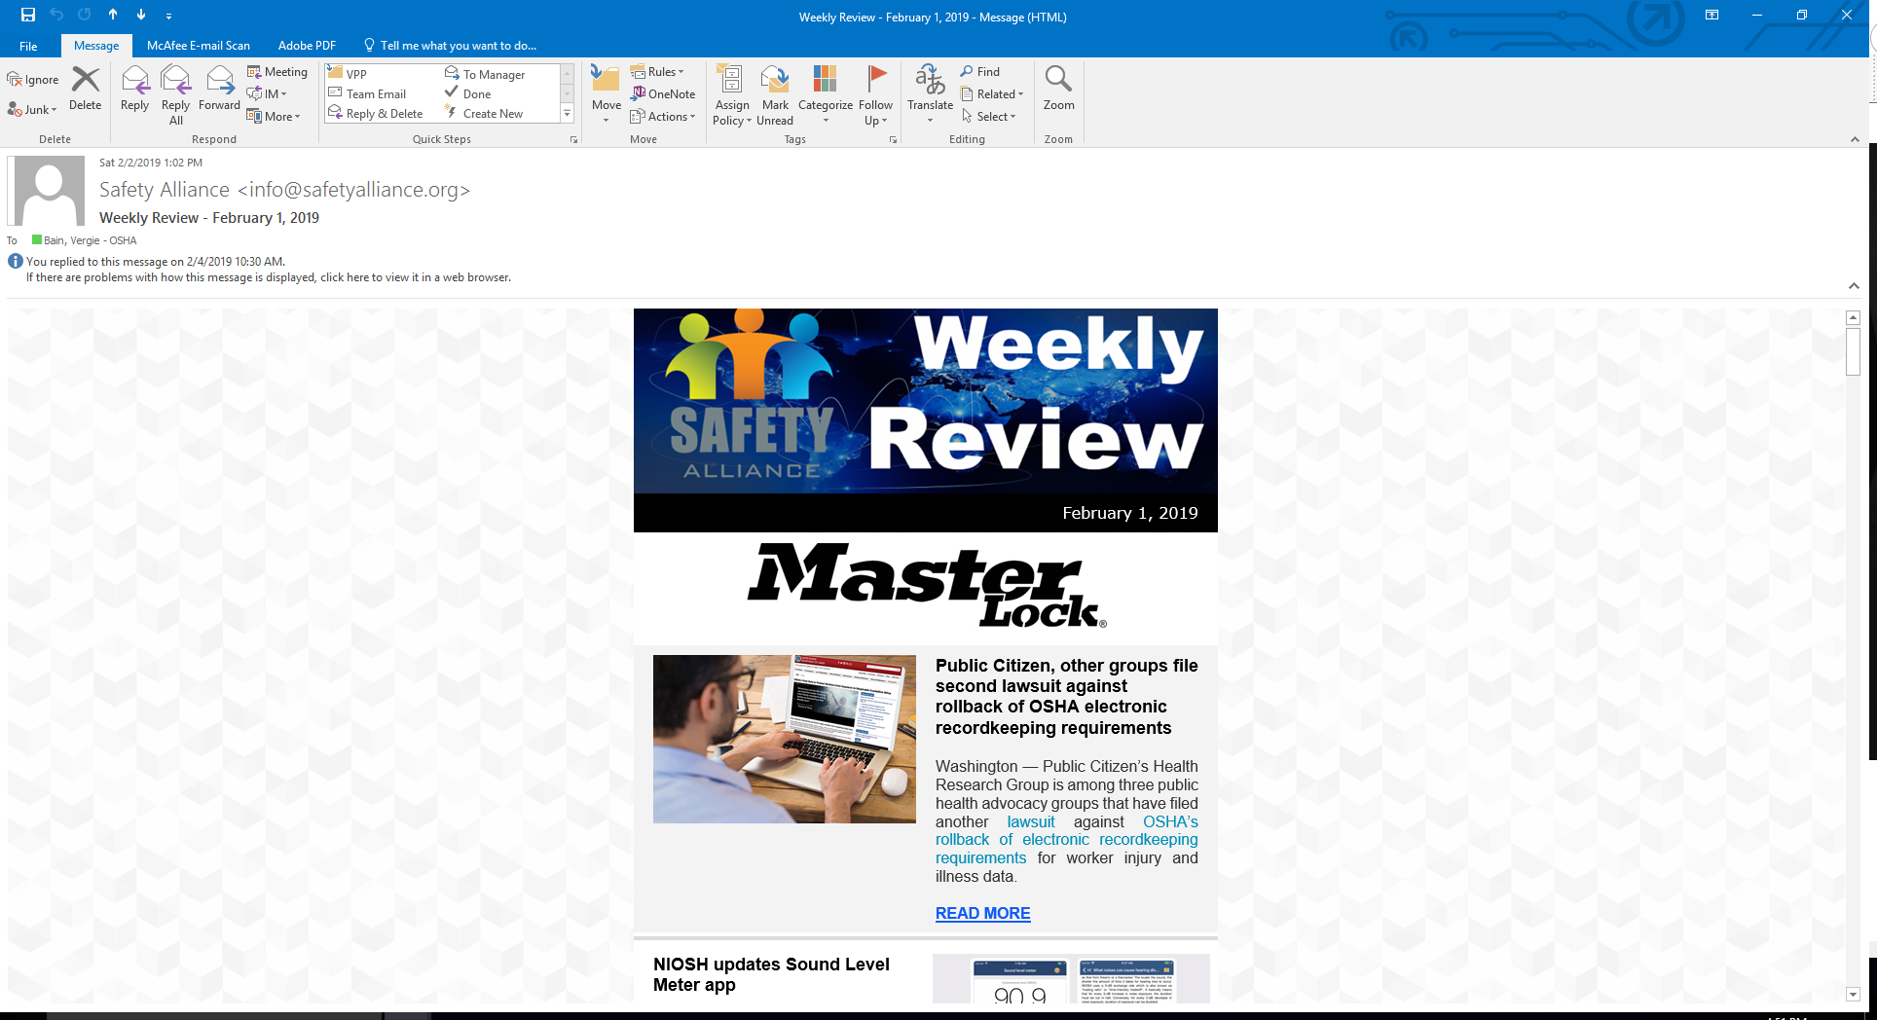
OSHA and Safe Alliance For Excellence

Slide 40

Questions

Slide 41

OSHA
www.osha.gov
800-321-OSHA (6742)

Slide 42
DISCLAIMER
This information has been developed by an OSHA Compliance Assistance Specialist and is intended to assist employers, workers, and others as they strive to improve workplace health and safety. While we attempt to thoroughly address specific topics, it is not possible to include discussion of everything necessary to ensure a healthy and safe working environment in a presentation of this nature. Thus, this information must be understood as a tool for addressing workplace hazards, rather than an exhaustive statement of an employer’s legal obligations, which are defined by statute, regulations, and standards. Likewise, to the extent that this information references practices or procedures that may enhance health or safety, but which are not required by a statute, regulation, or standard, it cannot, and does not, create additional legal obligations. Finally, over time, OSHA may modify rules and interpretations in light of new technology, information, or circumstances; to keep apprised of such developments, or to review information on a wide range of occupational safety and health topics, you can visit OSHA’s website at www.osha.gov.
Notes:
42
42
Brief over disclaimer.

